Slide 1
ELEMENTARY STATISTICS, BLUMAN
TI Calculator – Binomial Distribution
© 2019 McGraw-Hill Education. All rights reserved. Authorized only for instructor use in the classroom. No reproduction or further distribution permitted without the prior written consent of McGraw-Hill Education.

Slide 2
Objectives for this PowerPoint
How to calculate binomial probabilities using the TI Graphing Calculator

Slide 3
Problem
According to the 2012 Pet Ownership and Demographics Sourcebook, 36.5% of US households own at least 1 dog. If 10 US households are randomly selected, what is the probability that exactly 4 would own at least 1 dog?

Slide 4
Check Criteria
There are n = 10 trials.
There are only 2 possible outcomes; either a household owns a dog or does not.
Whether a randomly selected household owns a dog has no effect on the probability that another household owns a pet.
The probability of a success remains a constant 0.365 from trial to trial.

Slide 5
Example 1
According to the 2012 Pet Ownership and Demographics Sourcebook, 36.5% of US households own at least 1 dog. If 10 US households are randomly selected, what is the probability that exactly 4 would own at least 1 dog?
P(x = 4)
Use the binompdf function to find a binomial probability associated with one value of the random variable.

Slide 6
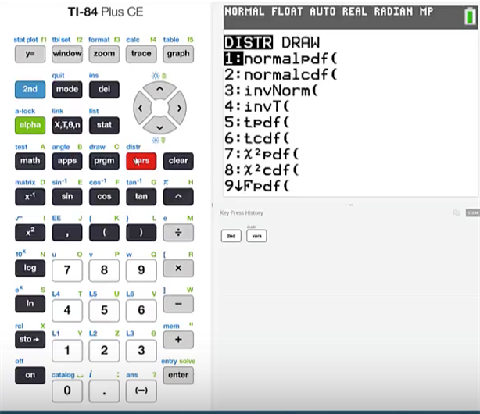
TI Calculator (1)
Click 2nd vars

Slide 7
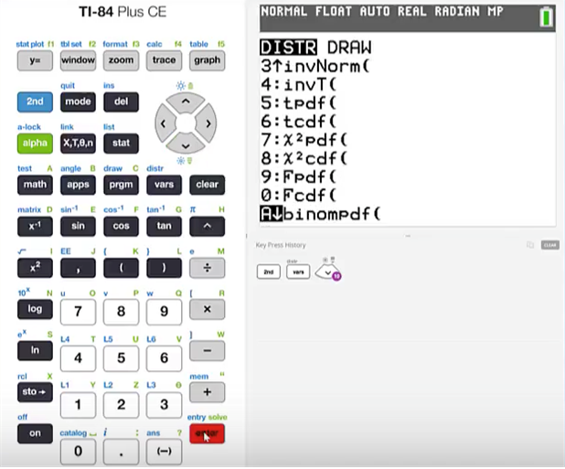
TI Calculator (2)
Cursor down until we get to the binompdf function
Click enter

Slide 8
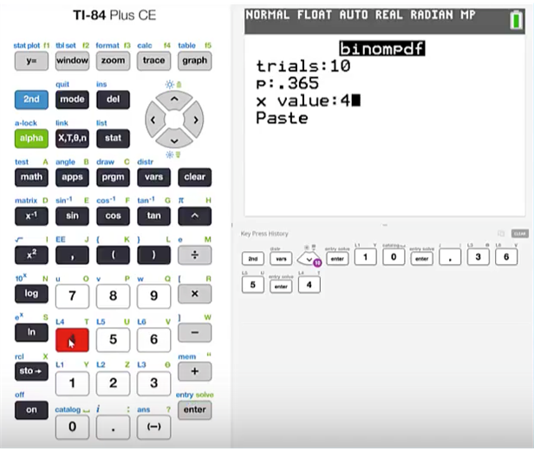
TI Calculator (3)
The number of trials is 10
The probability of a success is .365
Enter 4 for the x value
Click enter and then paste

Slide 9
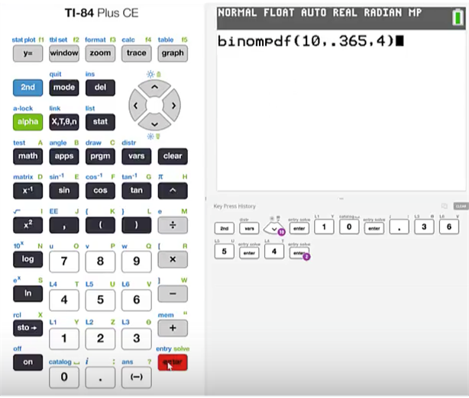
TI Calculator (4)
If you are using a TI graphing calculator that does not present a menu or entering the required values then you will need to place the values in order.
That order will be n, p, x with commas in between each value.
Press enter

Slide 10
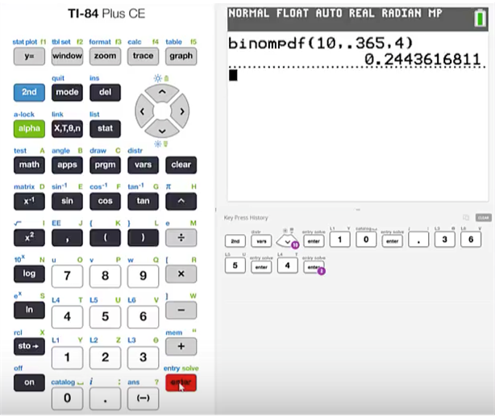
TI Calculator (5)
The probability for exactly 4 would own at least 1 dog is 0.2444

Slide 11
Summary
In this PowerPoint we learned how to calculate binomial probabilities using the TI Graphing Calculator.

